Slide 1


Company Portfolio
Welcome to Al Ghamdi Company for Sanitary Ware

Slide 2
Introduction
Our History
Our Key Assets
Companies Represented
Product List
Our Major Projects
Our Suppliers
Summary

Slide 3
Al Ghamdi Co. commenced its operations 48 Years ago by Sheikh Mohammed Al Ghamdi and Sheikh Mohammed Al- Issa. We are one of the leading companies in the Kingdom of Saudi Arabia dealing in sanitary ware fixtures, fittings, accessories. We enjoy very good reputa­tion among our clients and our after sales customer services are widely appreciated.
We are Sole: Exclusive agents in the Kingdom for American Standard
/ Ideal Standard and Bobrick the world's most leading manufacturers of Residential, Commercial and Institutional Sanitary ware Fixtures : Fittings and Accessories.
The production ranging from most elegant and luxurious, high quality stainless steel
accessories, vitreous china fixtures, handsome acrylic Bath tubs/ Whirlpool to a common bathroom available in superb craftsmanship with a wide range of today's most wanted colors.
Messrs American Standard Inc. U.S.A and Bobrick has a very practical approach while designing and manufacturing the Hospital fixtures, fittings and accessories which not only have the vital hygienic quality but also quite easy to use by the handicaps and patient
Introduction

Slide 4
M/s. Al Ghamdi Co. commenced its operations in 1970 by Sheikh Mohammed Al Ghamdi and Sheikh Mohammed Al-Issa. We are one of the leading companies in the Kingdom Of Saudi Arabia dealing in sanitary ware fixtures, fittings, accessories. We enjoy very good reputation among our clients and our after sales customer services are widely appreciated.
We are the Sole & Exclusive agents in the Kingdom for American Standard / Ideal Standard and Bobrick the world's most leading manufacturers of Residential, Commercial and Institutional Sanitary ware Fixtures &Fittings and Accessories. The production ranging from most elegant and luxurious, high quality stainless steel accessories, vitreous china fixtures, handsome acrylic Bath tubs/ Whirlpool to a common bathroom available in superb craftsmanship with a wide range of today's most wanted colours. Messrs American Standard Inc. U.S.A and Bobrick has a very practical approach while designing and manufacturing the Hospital fixtures, fittings and accessories which not only have the vital hygienic quality but also quite easy to use by the handicaps and patients.
Our History

Slide 5
We have well appointed and pleasantly Furnished showrooms in Riyadh and Jeddah that effectively cater to the retail demand in the respective cities and its hinterland
Showrooms
We have full-fledged Projects Sales Department to look after the needs
and requirements of the various projects. consultants / contractors and other institutional clients. We have been involved in the supply and delivery of our materials to many prestigious projects and clients. The Project Sales is the thrust area for the company at present and we are continuously expanding our horizons in this area.
Projects
Sales Department
Our Key Assets
They are the biggest asset of the company. We have qualified. talented and dedicated team of employees in all our departments to serve the client optimally.
Employees

Slide 6
We have an encompassing presence in the major city like Riyadh and Jeddah . We also have reached to interior of the region through a fleet of delivery of the materials right at the doorsteps of the customers
Coverage
We represent the pioneer of sanitary ware in the world with the sales of over $ Seven (7) billion and 94 manufacturing plants in 32 countries all around the world. Research and Engineering are located in Germany who is responsible for coordinating product development and insuring highest quality standard in each factory. In accordance with ISO 9001, En29001, BS5750. We have got all the systems in place to provide efficient service to our customers.
Our Key Assets
Infrastructure
The company has been in operation since years and our financial viability
is our major strength. The strong financial position has played an important role in the spectacular growth of the company over the year of existence
Finance

Slide 7

Companies Represented
American Standard
INC
(USA)
Ideal Standard
(European Union)
Viglacera
(Vietnam)
Bobrick Washroom Accessories
(USA)
Sonia
(Spain)
Blanco
(Germany)
Sloan valve Company
(USA)
Elkay Manufacturing Company
(USA)
Inda S.P.A
(Italy)
Geberit International
(Switzerland)

Slide 8
Product List
Brassware :
Metering / Proximatic
In-wall Valves
Two-handle Widespread Lavatory
Two-handle Centerset Lavatory
Two-handle Kitchen/Bar
Wall-mount Utility
Bedpan Cleansers
Pedal Valves/Vacuum Breakers
Electronic/Thermostatic
Pressure Balance Bath/Shower
Single Control Bath/Shower
Two and Three-handle In-wall Bath/Shower
Two-handle Deck Mount Tub Fillers
Single Control Lavatory
Two-handle Widespread Lavatory
Two-handleCenterset/SinglePostLavatory
Single Control Kitchen
Two-handle Kitchen
Specialty Faucets (Bar, Pantry, and Laundry)
Bidet Faucets
Commercial/Institutional Faucets
Vitreous China :
Pedestal Lavatories
Countertop Lavatories
Wall Hung Lavatories
Bidets
Toilets-One Piece
Toilets-Two Piece
Toilets (Commercial)
Urinals
Institutional
Acrylics:
Whirlpools/Bathtubs
Showers Trays

Slide 9
Product List
Accessories
Bathroom Accessories :
Accessories :
Mirrors
Paper Towel Dispensers
Sanitary Napkin Disposals
Soap Dispensers
  Toilet Tissue Dispensers
  Warm-Air Hand Dryers
  Waste Receptacles
Combination Towel/Waste
Units Grab Bars
Baby Changing Stati
Ash Trays
Bar Soap Holders Facial
Tissue Dispensers Hooks
Medicine Cabinets Shelves
Shower Curtains
Shower Curtain Rods Shower
Curtain Shower Seats
Toilet Brush Holder
Hotel Accessories :
Bar Soap Holder
Clothes Lines
Door Bumper
Hooks
Shelves
Soap Dishes
Towel Rods

Slide 10
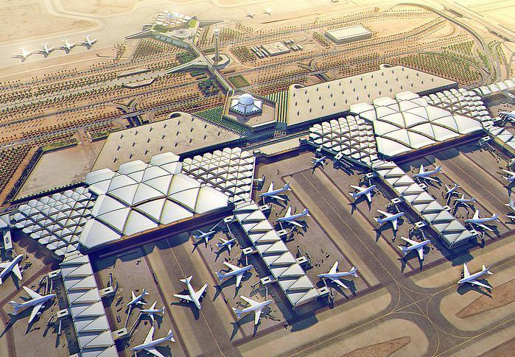
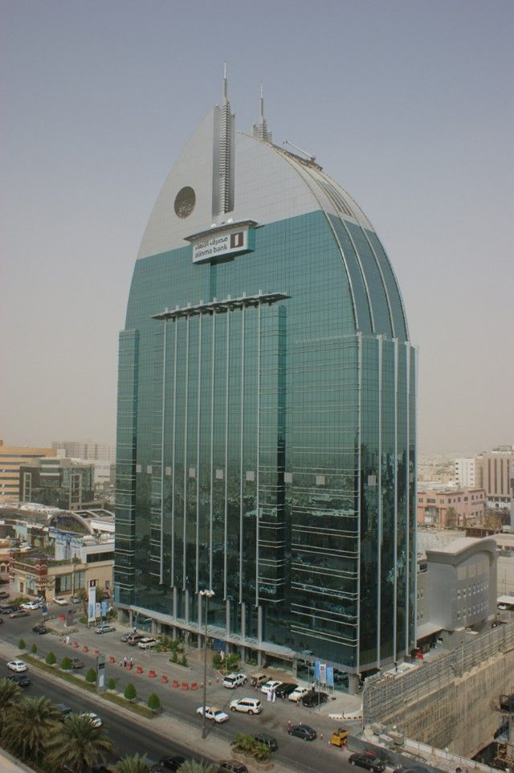
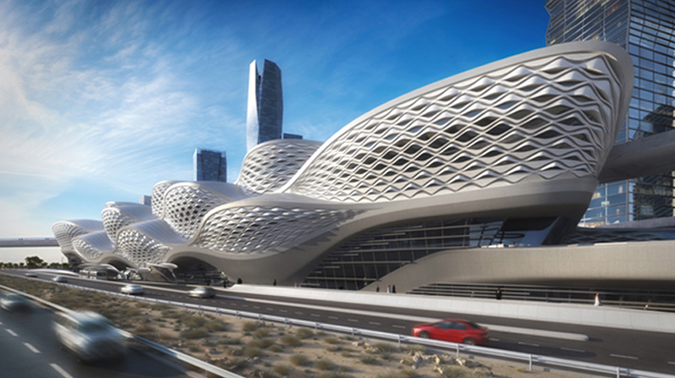
Our Major Projects
King Khaled international Airport
(Riyadh, Saudi Arabia)
Al Anoud Tower
(Riyadh, Saudi Arabia)
Riyadh Metro
(Riyadh, Saudi Arabia)

Slide 11
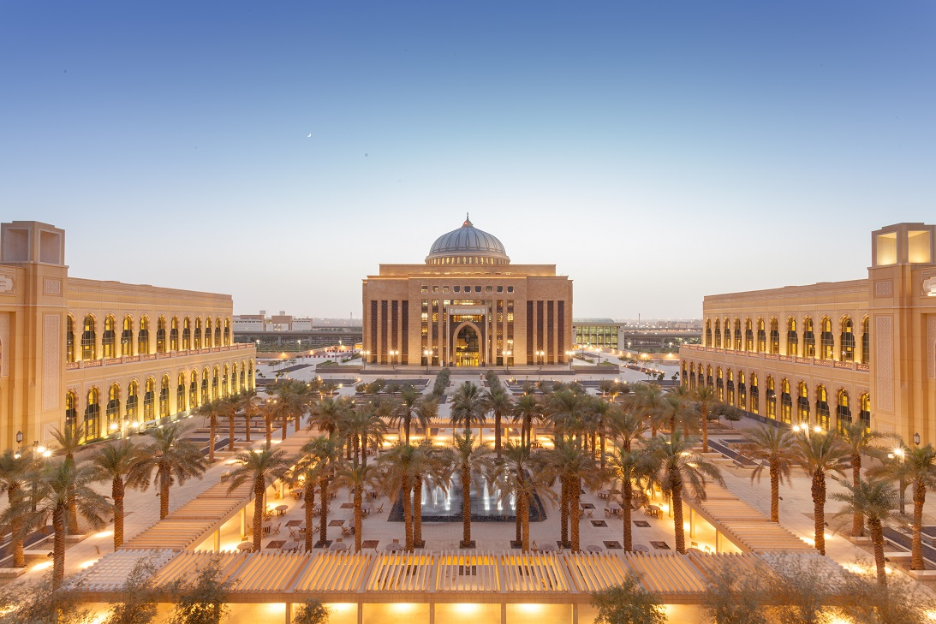
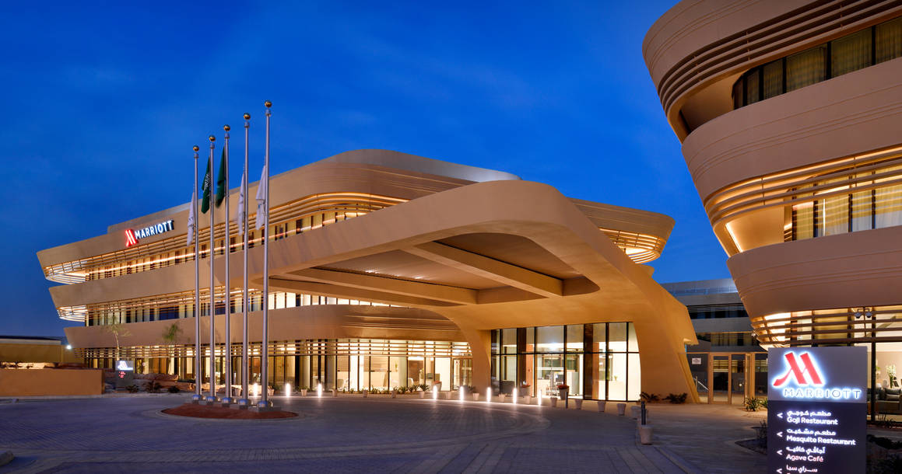
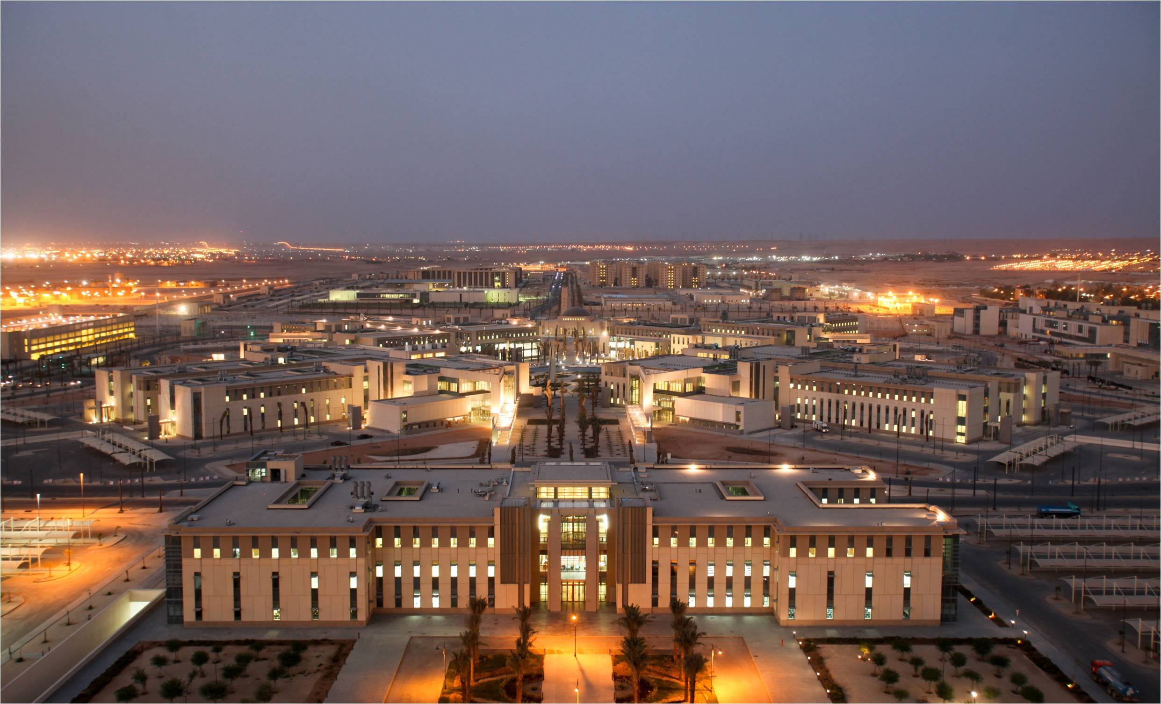
Our Major Projects
Princess Noura University
(Riyadh, Saudi Arabia)
Marriott hotel –DQ
(Riyadh, Saudi Arabia)
King Saud university
(Riyadh, Saudi Arabia)

Slide 12
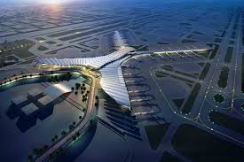
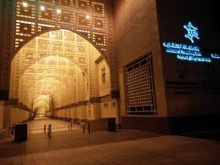
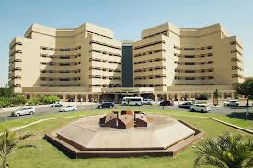
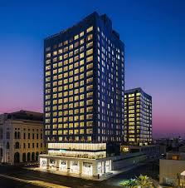
Our Major Projects
King Abdul Aziz International Airport
(Jeddah, Saudi Arabia)
Um Al Qura University
(Jeddah, Saudi Arabia)
King Abdul Aziz University
(Jeddah, Saudi Arabia)
Assila Hotel
(Jeddah, Saudi Arabia)

Slide 13












Our Suppliers

Slide 14
THANK YOU
Riyadh: Thakhasosi Street, Olaya. P.O.Box 53272, Riyadh 11573, KSA.
Jeddah :Thahlya Street, P.O. Box 3988 Jeddah 21481.
Dammam : P.O.Box 9289, Dammam 31413.
salesryd@amghamdi.com
salesjed@amghamdi.com
salesdam@amghamdi.com
Riyadh : 00966-11-4646279 / Fax: 00966-11-4646193.
Jeddah : 00966-012-6696263 / Fax: 00966-012-6612994
Dammam : 00966-03-8340248 / Fax: 00966-03-8347034

